Slide 1




Weekly report: Load & Dynamics
Week number: 13
Date: 23/12/2025
Supervisor: Mr. Manjock
Group members: Md Aman, Arham Memon, Paresh Nakum
23/12/2025
Md Aman, Arham Memon, Paresh Nakum
Optimus Syria

Slide 2
Agenda For Loads & Dynamics
Comparision Table
Variations in Percentage
Calculated Parameters of Mextremes
Mextremes Table For Machinery & Tower Components
Conclusion
Bibliography
23/12/2025
Md Aman, Arham Memon, Paresh Nakum
Load & Dynamics Team/ Optimus Syria

Slide 3
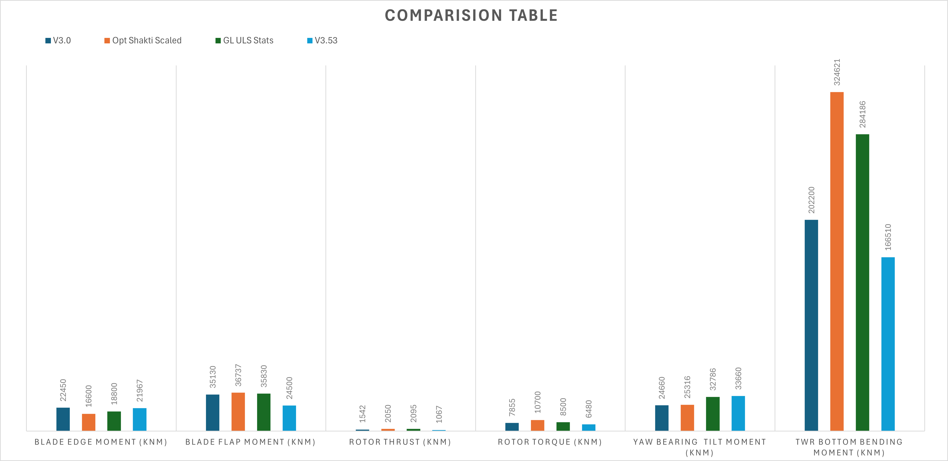
Comparision Table
23/12/2025
3
Md Aman, Arham Memon, Paresh Nakum
Load & Dynamics Team/ Optimus Syria

Slide 4
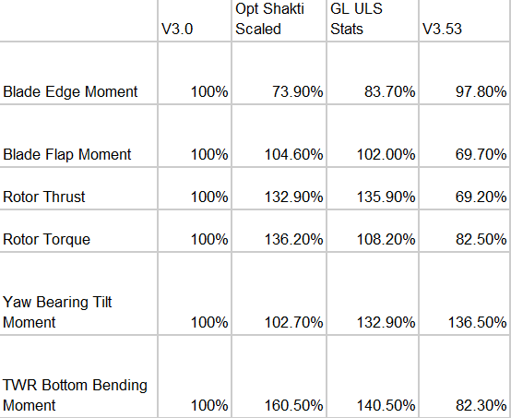
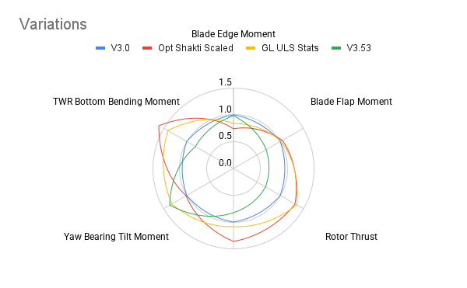
Variations in Percent
23/12/2025
4
Md Aman, Arham Memon, Paresh Nakum
Load & Dynamics Team/ Optimus Syria

Slide 5
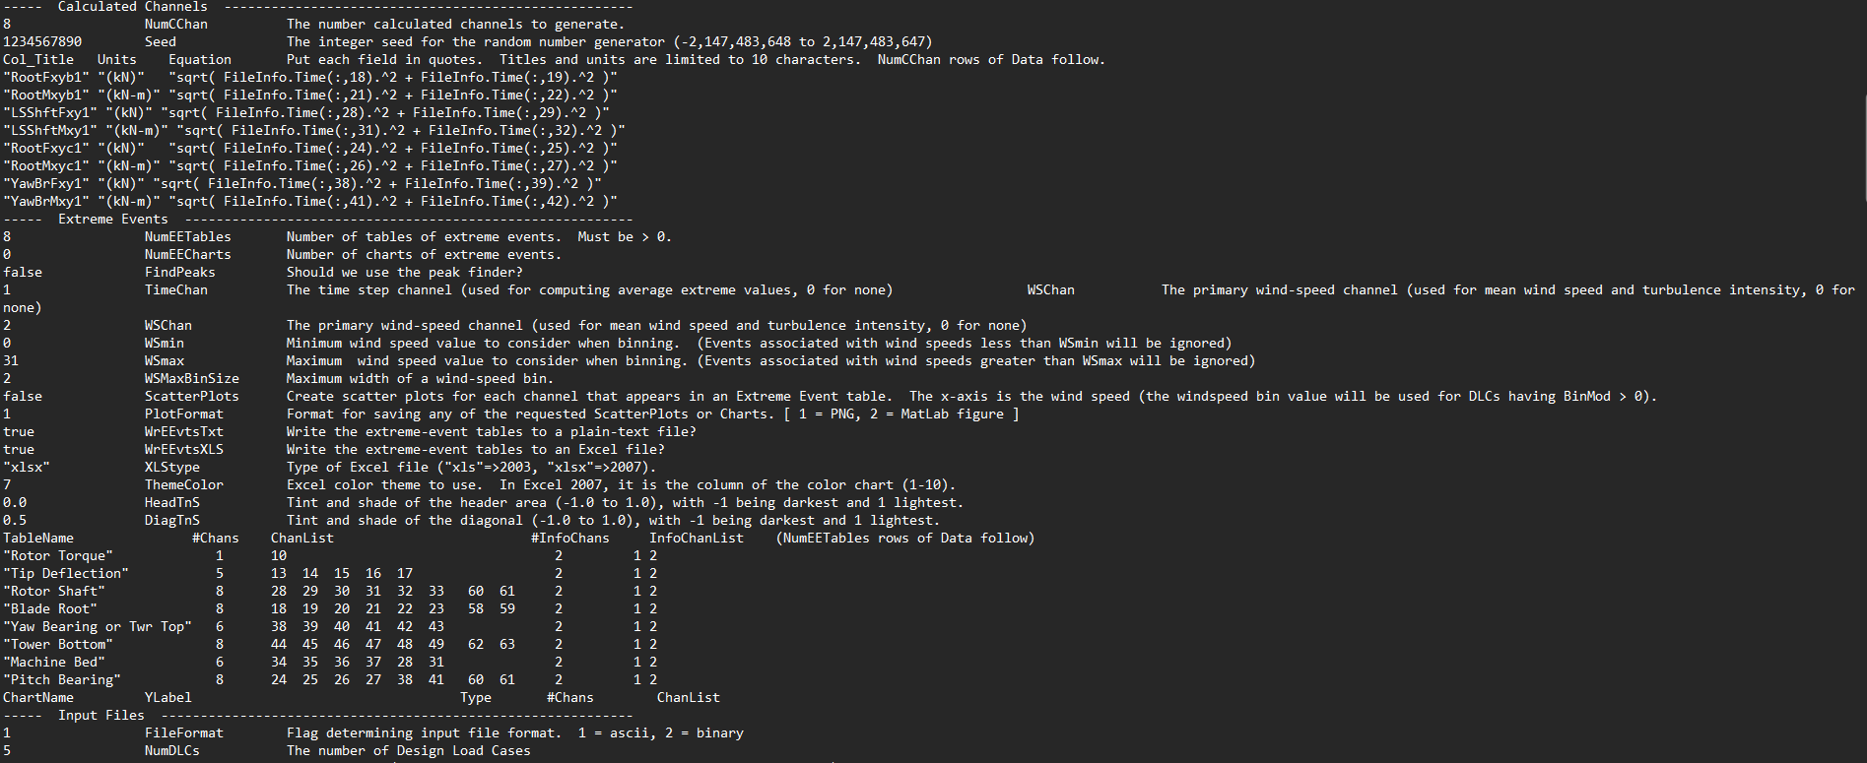
Calculated Parameters
Safety Factors included
Resultant Calculations
Calculated parameters
23/12/2025
5
Md Aman, Arham Memon, Paresh Nakum
Load & Dynamics Team/ Optimus Syria

Slide 6
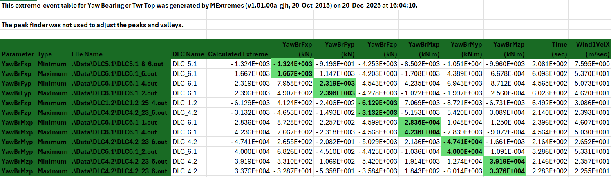
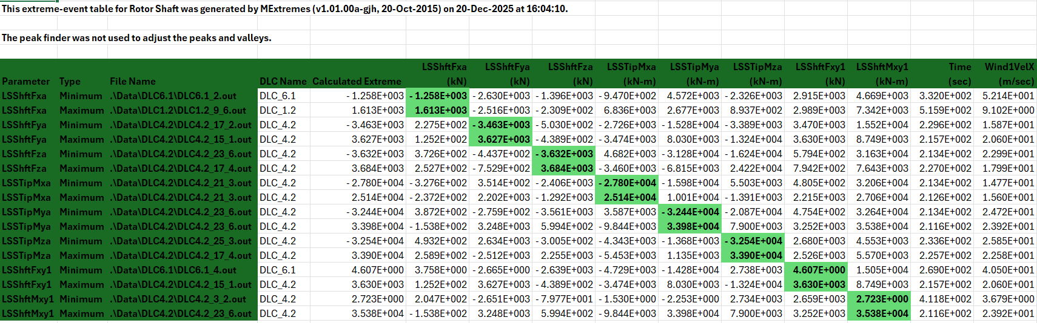
Tables For Machinery & Tower Components
23/12/2025
6
Md Aman, Arham Memon, Paresh Nakum
Load & Dynamics Team/ Optimus Syria

Slide 7
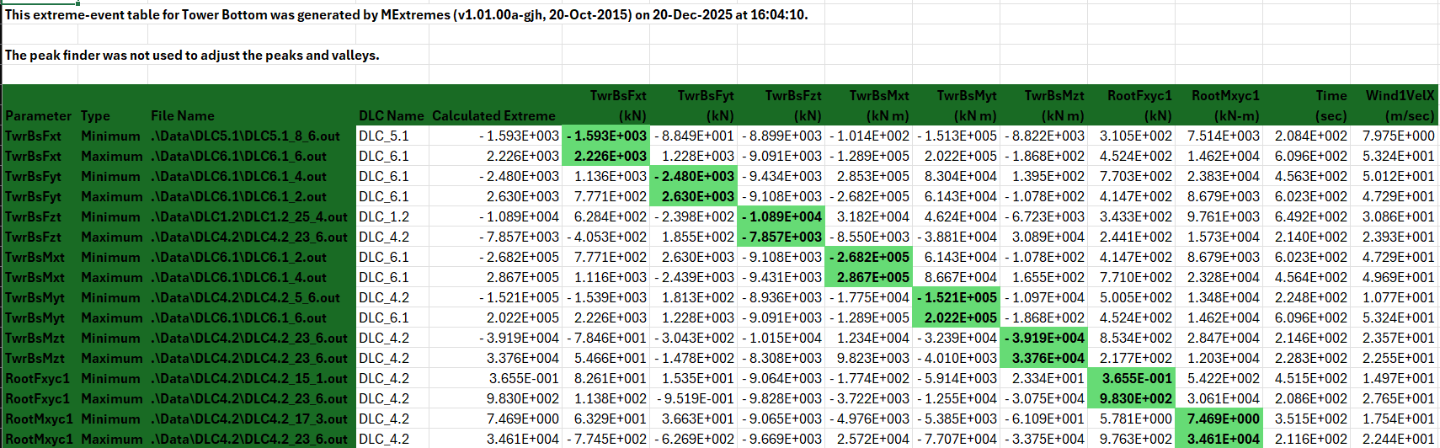

Tables For Machinery & Tower Components
23/12/2025
7
Md Aman, Arham Memon, Paresh Nakum
Load & Dynamics Team/ Optimus Syria

Slide 8
Conclusion
Completed Post Processing Result.
Generated Extremes with updated parameters.
Compared Result with scaled Shakti used by other teams for there calculations and GL Stats series results shows good optimization and will enhance with three below updates.
One more loop (5th) will generate in upcoming time when three file details got fixed
1. Blade Structure 2. LiDAR Controller for Optimus Syria 3. Nacelle Details by System Integrator.
23/12/2025
8
Md Aman, Arham Memon, Paresh Nakum
Load & Dynamics Team/ Optimus Syria

Slide 9
References
Standard, DNVGL-ST-0376 – Edition December 2016
TurbSim, OpenFAST_v3.0 & NREL 5 MW
MatLAB 2011b, MExtremes
23/12/2025
9
Md Aman, Arham Memon, Paresh Nakum
Load & Dynamics Team/ Optimus Syria

